Slide 1
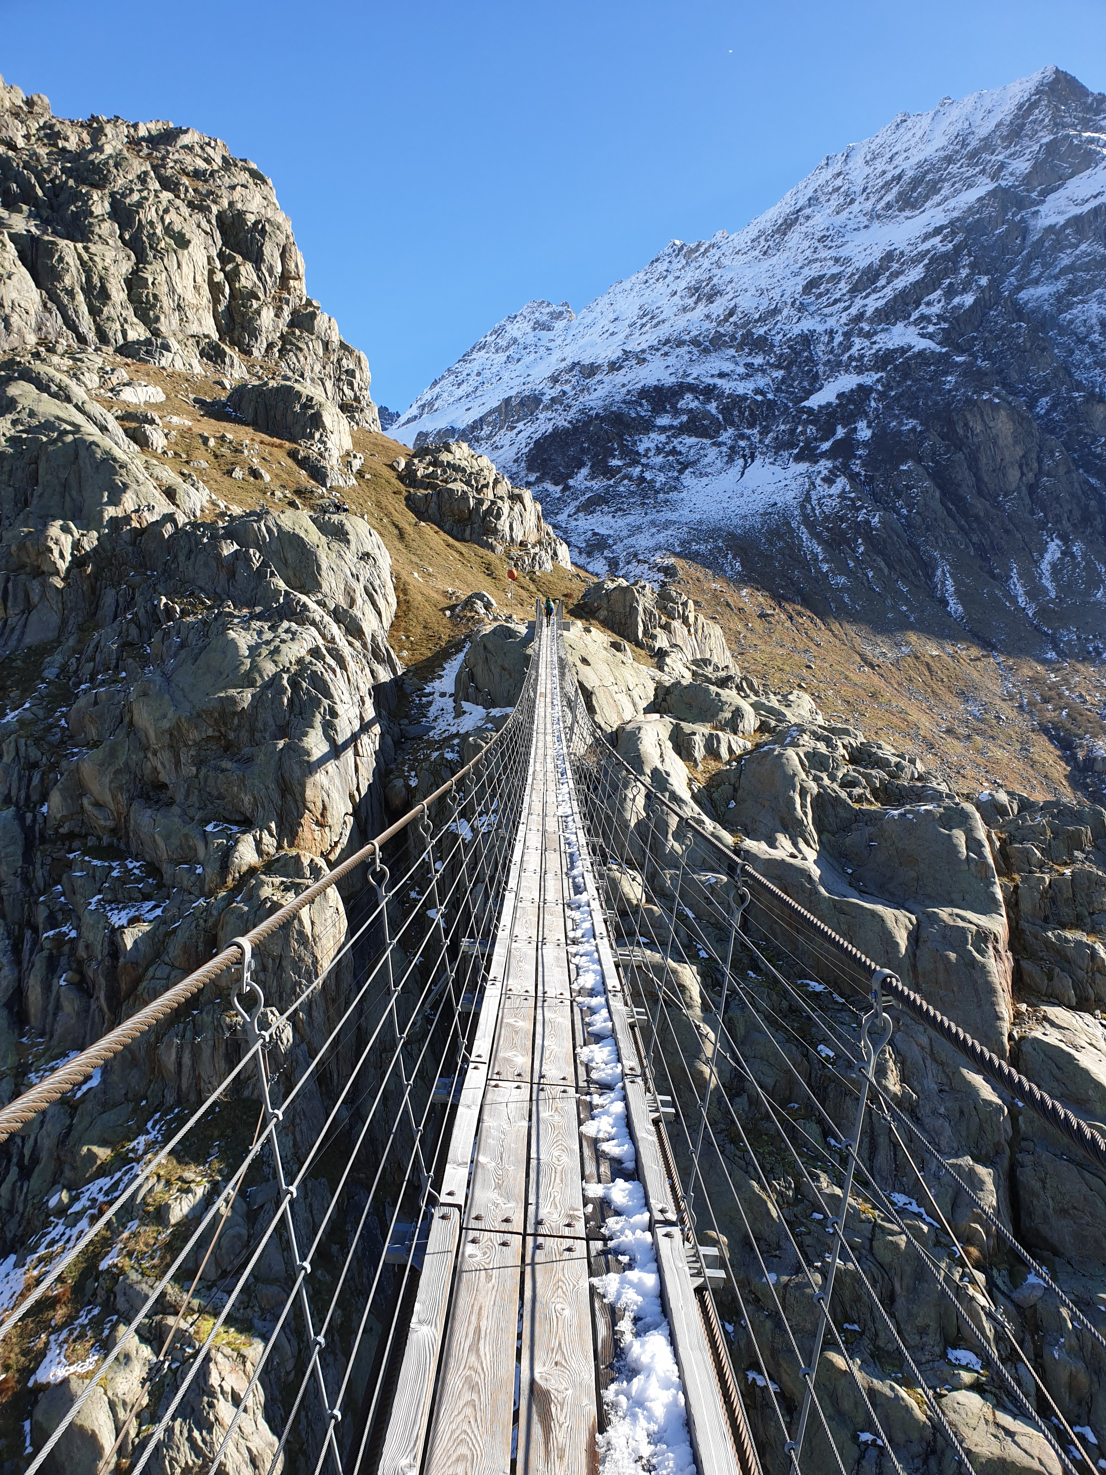
PIKELIS TRAVEL
SWITZERLAND · DAY TRIP · HIKE
Triftbrücke
from Zurich
Self-guided alpine day trip from Zurich
DURATION
SEASON
HIGHLIGHT
1 full day
June - October
170 m bridge

Slide 2
Trip Snapshot
PIKELIS TRAVEL
ROUTE DETAILS
KNOW BEFORE YOU GO
DURATION
1 day
Book Triftbahn gondola slots (roundtrip) a few weeks in advance – they sell out quick on weekends
Bring all food and water – no shops and restaurant not always open
Leave Zürich before 08:00 to catch optimal connections and avoid bridge crowds
Late start (leaving after 10:00 from Zürich) risks return timing
Check MeteoSwiss forecast – if >30% storm after 13:00, postpone
Hiking boots required - trail is rocky, descent is steep
Trail icy before June / after October
EFFORT
~3-4 h total (with gondola)
ALTITUDE
1,720 m (bridge level)
ASCENT (GONDOLA)
~450 m / ~6 km roundtrip
ASCENT (FULL HIKE)
~1,200 m / ~15 km roundtrip
BEST SEASON
June – October
HIGHLIGHT
170 m suspension bridge
ACCESS
BY CAR
Zürich → Triftbahn (~2 h, recommended)
BY PUBLIC TRANSPORT
Zürich HB → Triftbahn (~3.5 h, several changes)
GONDOLA
Available, from Triftbahn
⚠ Not suitable if you have a fear of heights or exposed bridge crossings.

Slide 3
Why this trip
PIKELIS TRAVEL
WHY THIS TRIP
DIFFICULTY AT A GLANCE
✓
Best suspension bridge hike near Zürich
↑
Steepness: consistent uphill ~1.5 h
Real glacier landscape without overnight stay
◎
Exposure: suspension bridge only
✓
Feels remote but fits into one day
~
Trail: marked alpine hiking path
✓
♡
Fitness: ~450 m ascent / ~6 km
✓
No technical skills required
WHO THIS IS FOR
NOT SUITABLE
✓
Based in Zurich for 1-2 days or more
⚠
If you have a fear of heights
✓
Comfortable walking uphill for 2-3 hours
⚠
If you have a fear of exposed bridge crossings
✓
Prefer independent travel
✓
Prefer clear step-by-step logistics, not inspiration

Slide 4
Choose your variant
PIKELIS TRAVEL
# | Route | Ascent | Descent | Distance | Time to | Return | Recommended for
1 | Gondola up, gondola down | ~450 m | ~450 m | ~6 km | ~1 h 30 | ~1 h 15 | Fast visit
2 | Gondola up, hike down | ~450 m | ~750 m | ~9 km | ~1 h 30 | ~2 h 30 | Best balance
3 | Full hike from Gadmen | ~750 m | ~750 m | ~12 km | ~3 h | ~2 h 30 | Strong hikers
1. Gondola up, gondola down
Fastest option. Minimises elevation gain and descent stress on knees. Good for mixed fitness groups or tight time windows.
2. Gondola up, hike down
Best overall balance. Dramatic views on descent. Walk down through the valley at a relaxed pace.
3. Full hike from Gadmen
For strong hikers who want to earn the bridge fully on foot. Adds ~2 h and ~300 m elevation. Do only if you arrive by car.

Slide 5
Getting there from Zurich
PIKELIS TRAVEL
STANDARD – CAR (RECOMMENDED)
DRIVE
Zürich → Triftbahn (~2 h)
ROUTE
Via Meiringen, turn onto Sustenstrasse toward Susten Pass
PARKING
Small lot at Triftbahn station, just past Gadmen
GPS
46°43′15.4″N 8°19′06.0″E
Car gives full timing flexibility - no bus dependency on return. Full hike option: skip gondola and hike from Triftbahn
ALTERNATIVE – PUBLIC TRANSPORT
TRAIN
Zürich HB → Luzern → Meiringen → Grimseltor / Innertkirchen (~3 h)
BUS
Innertkirchen / Grimseltor → Nessental, Triftbahn (~15 min)
TOTAL TRAVEL
~3.5 h each way to gondola station
TICKET
SBB app: Zürich HB ↔ Nessental, Triftbahn (includes bus)
Can be tight unless you maintain a steady hiking pace, with a higher risk of needing to turn around before reaching the bridge
⚠ Book train/bus tickets several weeks in advance – Saver fares are often significantly cheaper

Slide 6
Gondola schedule
PIKELIS TRAVEL
TRIFTBAHN – OPERATING TIMES
KEY FACTS
ASCENT ↑
DESCENT ↓
CAPACITY
8 people per cabin
08:00
08:00
FREQUENCY
Every 10 minutes
08:10
08:10
PRICE
CHF 30 / adult return
every 10 min
every 10 min
SWISS PASS
No discount
15:50
15:50
BOOKING
Online in advance
16:00 – Last ascent
16:00 – Last descent
FLEXIBILITY
None - fixed time slot
FREQUENTLY ASKED QUESTIONS:
RESERVATIONS
Timing. Allow at least 4 hours between ascent and descent slots. From gondola exit to bridge and back: ~3 h at a comfortable pace
Being late. Yes, Some hikers do not reach the gondola in time for their booked descent. Flexibility is limited and depends on the gondola operator on the day, so allow extra buffer time
https://www.grimselwelt.ch/en/experiences/hike-to-the-suspention-bridge-triftbruecke/
⚠ Don't miss the last gondola – book your return slot when purchasing. Allow buffer time for the descent

Slide 7
Step-by-step day plan
PIKELIS TRAVEL
BY CAR
~06:30
Depart Zürich
Departing early reduces chance of traffic jams. Drive is ~2 h.
~08:30
Arrive at Triftbahn
Parking fills quickly, especially on weekends - arrive early for the best chance of securing a space closer to Triftbahn.
~08:50
Triftbahn gondola
Take gondola to the top (pre-booked). Trail starts from gondola exit. Trekking poles recommended. Ascent is ~1.5 h.
~11:00
Triftbrücke
170 m suspension bridge above turquoise glacier lake. Cross both ways. Wind moving the bridge is normal.
~12:30
Lunch + descent start
Eat before descending. Descent is ~1.5 h.
~14:10
Back at Triftbahn
Take gondola down.
~14:30
⚠ LATEST SAFE START TIMES
Depart Triftbahn
Expect longer drive back on weekends and holidays. Drive is ~2 h.
DEPART ZÜRICH
Before 08:00
~16:30
Back in Zürich
LATEST GONDOLA UP
~11:30
~10 h round trip door to door.
TRAIL TURNAROUND
~13:30

Slide 8
Step-by-step day plan
PIKELIS TRAVEL
BY PUBLIC TRANSPORT
~08:10
Depart Zürich HB
Train to Luzern, connection to Meiringen, then Innertkirchen / Grimseltor. Confirm exact time on SBB app. Train is ~3 h.
~10:50
Arrive Innertkirchen
Connect to bus toward Nessental, Triftbahn. Bus is infrequent but aligned with the train schedule. Confirm on SBB app. Bus is ~15 min.
~11:10
Triftbahn gondola
Take gondola to top (pre-booked). Trail starts from gondola exit. Trekking poles recommended. Ascent is ~1.5 h.
~13:00
Triftbrücke
170 m suspension bridge above turquoise glacier lake. Cross both ways. Wind moving the bridge is normal.
~14:00
Lunch + descent start
Eat before descending. Descent is ~1.5 h.
~16:00
Back at Nessental
Take gondola down. Check return bus to Innertkirchen on SBB app.
⚠ LATEST SAFE START TIMES
~16:40
Depart Triftbahn
DEPART ZÜRICH
08:00
Bus every 1h; for example; 16:40, 17:40, 18:40 (the last one).
LATEST GONDOLA UP
~11:30
~20:00
Back in Zürich
TRAIL TURNAROUND
~13:30
~12 h round trip door to door.

Slide 9
Weather rules
PIKELIS TRAVEL
GO WHEN
DON'T GO WHEN
Clear morning forecast
Strong wind warning (bridge closes)
No thunder risk after 13:00
Storm forecast after 13:00
June – October
Before June – snow likely
No strong wind warning
After October – icy conditions
Crowd tip:
Bridge quietest before 12:00
Worst days: Saturdays in July & August
⚠ MeteoSwiss app – set location to Gadmen. If >30% storm probability after 13:00, postpone.

Slide 10
Cost & What to bring
PIKELIS TRAVEL
COST BREAKDOWN
Triftbahn gondola return (no Swiss pass discount)
CHF 30 / adult
Car parking at Triftbahn station
~CHF 5–8 / day
Public transport: Zürich HB ↔ Nessental (Triftbahn), 2nd class return
~CHF 40-140 /adult
Public transport ticket prices depend on booking timing.
Standard return ticket: ~CHF 110–140
Saver Day Pass (advance purchase): ~CHF 39–79
Saver Day Pass (last-minute): ~CHF 99–119
WHAT TO BRING
●
Waterproof hiking boots
●
Trekking poles (descent)
●
Wind layer / shell jacket
●
Sun protection + sunglasses
●
Warmer layer (fleece)
●
Headlamp (if late return)
●
Lunch + snacks (no food at bridge)
●
SwitzerlandMobility and SBB App (for route)
●
2 L water minimum
●
Charged phone + offline timetable
⚠ No shop or water source between Gadmen and the bridge. Bring everything from Zürich.

Slide 11
Before you go
PIKELIS TRAVEL
✓
Check MeteoSwiss forecast at Gadmen – postpone if >30% storm after 13:00
✓
Reserve Triftbahn gondola ascent & descent slots in advance (allow ≥4 h between ascent and descent). It sells out on weekends
✓
Check SBB timetable: Zürich HB → Nessental, Triftbahn. Check last PostBus departure from Nessental, Triftbahn
✓
Pack lunch + snacks and 2 L water minimum (no supply at bridge)
✓
Download SwitzerlandMobility App (the route is clearly marked, but helps to follow)

